Slide 1
Resource Allocation / Best Practice

Slide 2

Discussion points
Can I use the entire cluster at once?
Where should I write data to?
Which queue/partition should I use?
How much CPU/memory should I allocate to a job?
“It depends”
https://help.cropdiversity.ac.uk/slurm-policy.html

Slide 3
Can I use the entire cluster at once?
It depends…
the question is really: should I use the entire cluster at once?
While there are currently no limits to prevent you from submitting a job that uses every CPU across one or more queues, you first need to ask yourself how sensible that would be? Consider:
how long the job will last?
how busy is the cluster?
how much you value your friendship with other cluster users?
Notes:
Short running tasks allow others’ jobs to rise in priority above yours (the fair-share policy), so submitting a 10,000 jobs that only last a few minutes each will ‘hog’ the cluster much less than just a few tens or hundreds of jobs that last for hours and hours. If it’s 2am and no-one else is using the cluster, then it’s less likely to be detrimental to anyone else. This is a shared resource, and while it’s here to be used, it’s not here to be abused.

Slide 4

Where should I write data to?
Where you decide to store data will have an effect on performance, available capacity, and backup policies, so it’s important that you understand the differences between the storage locations and the folders they contain
home folders
/home
project folders
/mnt/shared/projects
scratch space
/mnt/shared/scratch

Slide 5
Where should I write data to?
Data can be both shared (visible to all nodes) and local (visible to each specific node only)
home folders
/home
project folders
/mnt/shared/projects
scratch space
/mnt/shared/scratch
node scratch space
$TMPDIR
shared BeeGFS storage (1.5 PB)
local SSDs (1-2 TB max)

Slide 6


Backups
Backup policies differ across the tiers:
home folders
30 dailies
project folders
30 dailies and 18 monthlies
scratch space
node scratch space
not backed up

Slide 7
What to store where
Project folders:
What to store: data from “official” projects -- raw data, scripts, results that need to be kept long term
What NOT to store: bulky, intermediate files that can be recreated (e.g. BAM files), “debris” created by messy software packages (e.g. thousands of small files from a Trinity assembly)
Scratch:
What to store: data analysis outputs in progress
What NOT to store: anything that requires permanent storage should be moved to the projects folder if/when you’re sure that you need to keep it
Home folders:
What to store: as little as possible (<10GB)
What NOT to store: “official” project data, big files

Slide 8

Storage performance
Our BeeGFS filesystem maximum file transfer rate is around 12 GB/s
it’s great for parallel transfers of large data to multiple jobs at once
but it doesn’t like working with lots and lots of very small files
Local node scratch uses SSDs
while it can’t match the large streaming transfer rates of the BeeGFS system, it will always win when reading/writing lots of very small files
but it’s limited in size
and only exists for the lifetime of each job

Slide 9
Where to process data
Is it faster to:
a) read and write everything in shared scratch?
b) read from shared scratch and write to local scratch?
c) copy everything to local scratch and work from there?
Either way, b and c also require results to be copied back to shared scratch before the job ends
But if you’re doing a lot of random I/O (or a lot of small file I/O) then chances are things will be much faster with local scratch

Slide 10
Traditional file servers
server #1
server #2
server #3
server #4
compute nodes
different file servers hold different projects, causing a cross-cluster
job to put huge demand on just that one server

Slide 11
HPC parallel file array
single global namespace
server #1
server #2
server #3
server #4
compute nodes
a parallel file system spreads the load across all servers, increasing capacity and performance

Slide 12

The Linux kernel
Release 5.19.2 (2022-08-17)
just 126MB compressed
but almost 82,000 files and folders
https://cdn.kernel.org/pub/linux/kernel/v5.x/linux-5.19.2.tar.xz

Slide 13
Activity: unzip the kernel source
#!/bin/bash
#SBATCH --partition=debug
time tar -xf kernel.tar.xz
GROUP 1 (network)
#!/bin/bash
#SBATCH --partition=debug
cd $TMPDIR
cp ~/scratch/training/kernel.tar.xz .
time tar -xf kernel.tar.xz
cp linux-5.19.2/README ~/scratch/training/
GROUP 2 (local scratch)

Slide 14
Monitoring network I/O
You can keep an eye on your network (/mnt/shared/) input/output via:
You’ll probably need to maximize your screen
Prints (every 5s) a summary of each user’s current file I/O
$ beegfs-ctl --userstats --names

Slide 15
Transparent file compression
All data on our shared spaces is transparently compressed
$ ls –lh raspberry.fasta
-rw-r--r-- 1 username username 289M Mar 10 13:00 raspberry.fasta
$ du –h raspberry.fasta
181M raspberry.fasta
$ du -h --apparent-size raspberry.fasta
289M raspberry.fasta
$ ls -lh raspberry.fasta.gz
-rw-r--r-- 1 username username 84M Mar 10 13:00 raspberry.fasta.gz
actual size
compressed size
actual size
even smaller

Slide 16
Which queue/partition should I use?
It depends….
Time limits:
Short queue – 6 hours
Medium – 24 hours
Long – no limit
Historical observation and anecdotal evidence:
a significant number of jobs seem to complete OK within 24 hours (so use medium)
but the bigger your job or data sets that you want to process, the more likely it is to overrun and therefore be safer on the long queue
however, if the long queue is busy, you may then have to wait longer for your job to start
Note though, that each task of an array job has its own time allocation, so you could still successfully run a week-long job on the medium queue if each of its subtasks completes in less than 24 hours.
If it’s an interactive job, then you’re probably better off running it on the short queue.
gpu/himem queues are special cases
these resources are scarce, so be very considerate in your use of them, especially for long running jobs

Slide 17
How much CPU/memory should I allocate to a job?
Allocating CPUs or memory is easy – but allocating the correct amount of CPU or memory is more challenging
too few CPUs; your job runs slower
too many CPUs (i.e. idle CPUs due to bottleneck having moved elsewhere) ; you’re wasting resource and blocking others
too little memory; your job will fail – required so that nodes don’t crash
too much memory; you’re wasting resource and blocking others
Each program and/or data set will be different; experimentation is really the only way to know for sure
Memory: start with little, ramp it up until your job doesn’t run out of memory any more
For array jobs, start by running a single job only until you have optimised the memory consumption:
$ sbatch --array=1 myScript.sh
(providing instructions for slurm as an argument to 'sbatch' overrides their equivalent in the script)

Slide 18
Limiting CPU usage
Slurm can also limit CPU usage
If you ask for one CPU, that’s all you get
no sneaking in multi-core usage above your allocation
but also means no need to worry about long jobs with short periods of heavy multi-core use
Watch out for:
hyperthreading is enabled; “CPUs” are allocated to jobs and their tasks at the level of a physical core, so two different jobs or job tasks will not share a physical core. For example, a job requesting resources for three threads will be allocated two full physical cores, but still only have use of three.
therefore better to just always request CPUs in even numbers
CPU: 16C (32T)
X | X |  |  | X | X | X | X
 |  | X | X | X | X | X | X

Slide 19
CPUs/cores and parallel jobs
1x 1-core job (--cpus-per-task=1)
2 hyperthreads are allocated; only one can be used
CPU #1 16C (32T)
X | X
CPU #2 16C (32T)
CPU #3 16C (32T)
CPU #4 16C (32T)

Slide 20
CPUs/cores and parallel jobs
1x 8-core job (--cpus-per-task=8)
8 hyperthreads are allocated; all can be used
CPU #1 16C (32T)
X | X | X | X | X | X | X | X
CPU #2 16C (32T)
CPU #3 16C (32T)
CPU #4 16C (32T)

Slide 21
CPUs/cores and parallel jobs
2x 8-core job (--cpus-per-task=8)
8 hyperthreads are allocated (per job); all can be used
CPU #1 16C (32T)
X | X | X | X | X | X | X | X
CPU #2 16C (32T)
X | X | X | X | X | X | X | X
CPU #3 16C (32T)
CPU #4 16C (32T)

Slide 22
CPUs/cores and parallel jobs
1x 1-core array job (--array=1-8 --cpus-per-task=1)
2 hyperthreads are allocated (per task); only 1 (per task) can be used
CPU #1 16C (32T)
X | X | X | X | X | X | X | X
X | X | X | X | X | X | X | X
CPU #2 16C (32T)
CPU #3 16C (32T)
CPU #4 16C (32T)

Slide 23
CPUs/cores and parallel jobs
2x 8-core array job (--array=1-8 --cpus-per-task=8)
8 hyperthreads are allocated (per task); 8 (per task) can be used
CPU #1 16C (32T)
X | X | X | X | X | X | X | X
X | X | X | X | X | X | X | X
X | X | X | X | X | X | X | X
X | X | X | X | X | X | X | X
CPU #2 16C (32T)
X | X | X | X | X | X | X | X
X | X | X | X | X | X | X | X
X | X | X | X | X | X | X | X
X | X | X | X | X | X | X | X
CPU #3 16C (32T)
X | X | X | X | X | X | X | X
X | X | X | X | X | X | X | X
X | X | X | X | X | X | X | X
X | X | X | X | X | X | X | X
CPU #4 16C (32T)
X | X | X | X | X | X | X | X
X | X | X | X | X | X | X | X
X | X | X | X | X | X | X | X
X | X | X | X | X | X | X | X

Slide 24
Monitoring jobs
https://cropdiversity.ac.uk/top

Slide 25
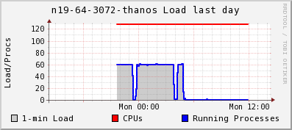
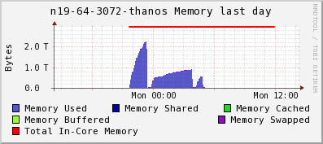
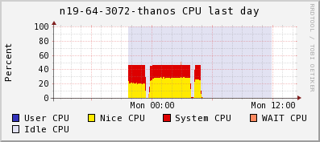
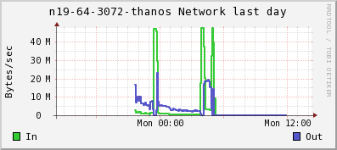
Monitoring jobs
https://ganglia.cropdiversity.ac.uk

Slide 26
Allocating memory
Default memory allocation per job task is 1.5GB
If you need more, you have to ask for it:
--mem=32G
If your job uses more than the allocation:
it may fail because it can’t get enough memory
it may be killed because it used too much
A significant number of jobs request too much…

Slide 27
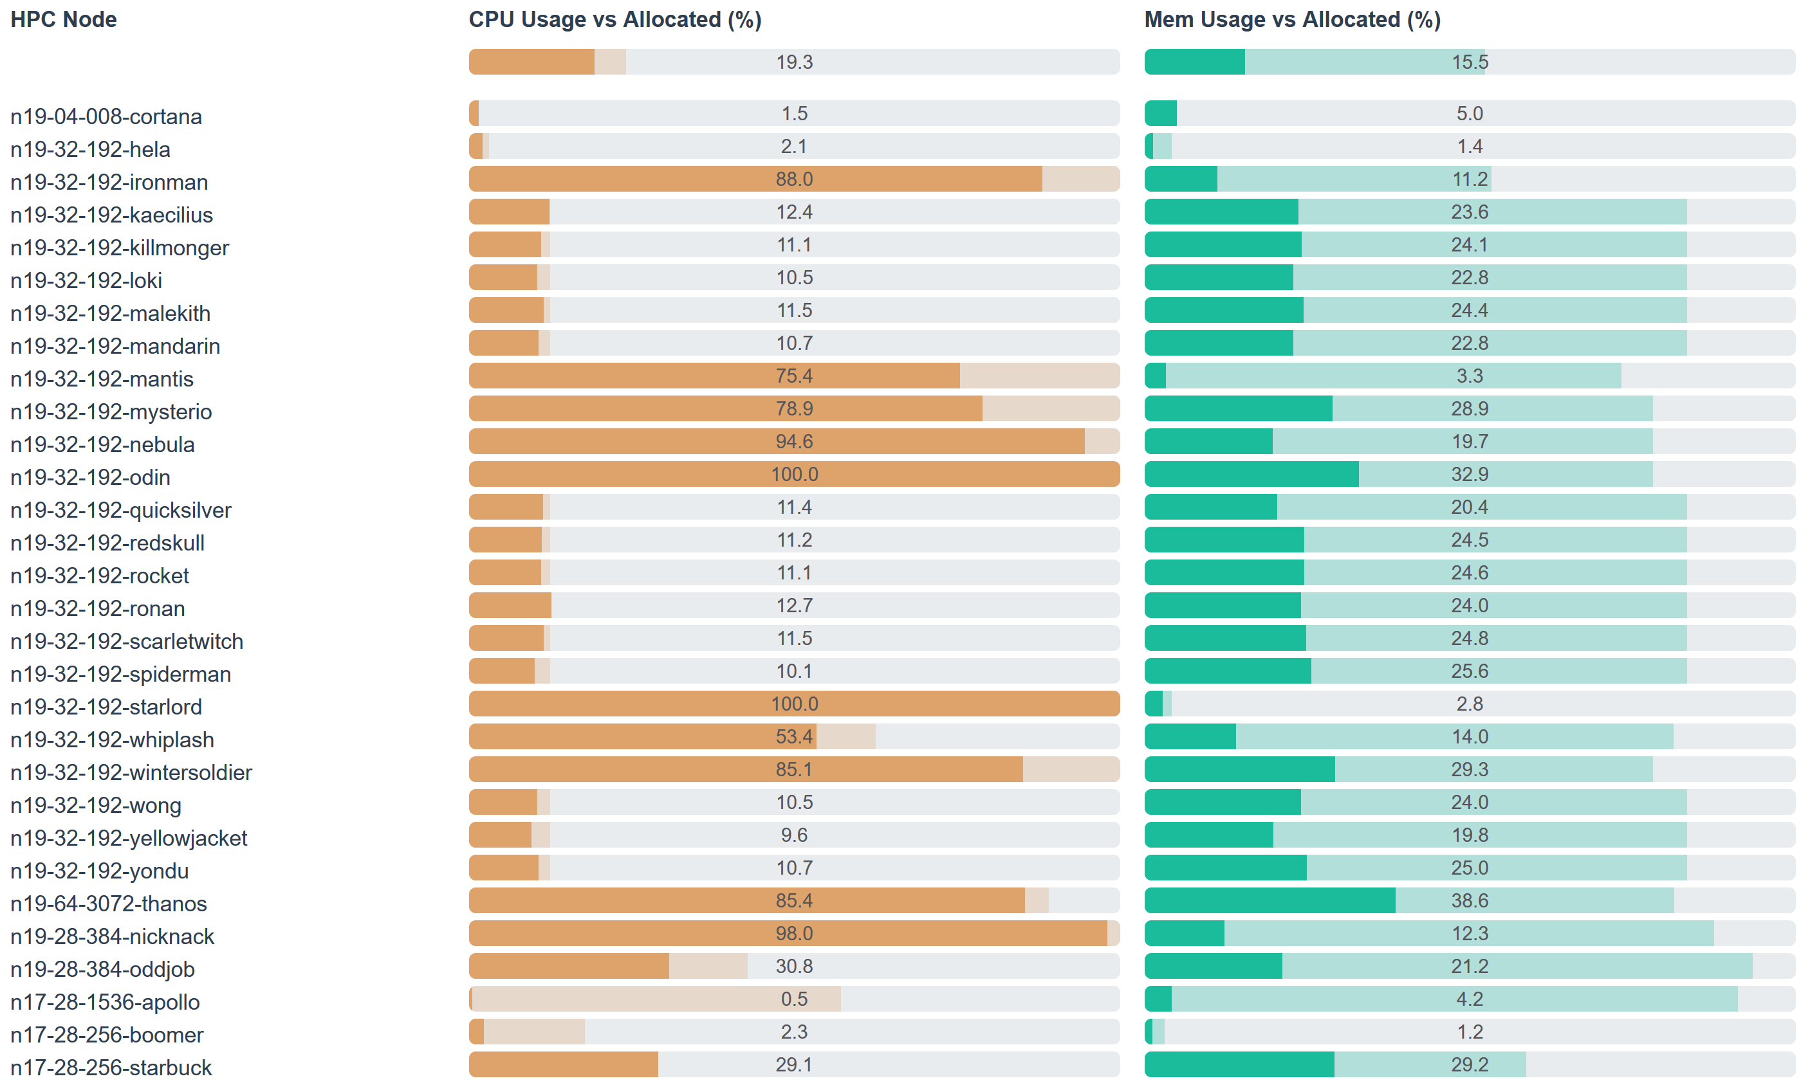
Allocating memory

Slide 28
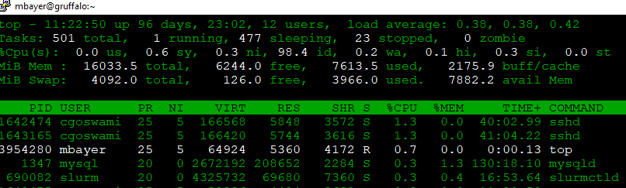
What resources is my job currently consuming?
Run squeue to see which node your job is running on
Connect to the node: ssh <node_name>
Once connected, run: top or htop
Jobs will be listed with user names, along with their resource consumption:
Memory consumption in KB
CPU usage - % of a single CPU (multiples of 100% for multithreaded jobs)
Remember: both CPU and memory consumption can fluctuate over the lifetime of your job!

Slide 29
How much memory is my job using?
top/htop provide live info
Slurm can provide limited information on a running job
Start something running, then try:
sjobstat is an alias for:
$ sjobstat –j jobid
JobID MaxRSS
------------ ----------
537245.batch 85230296K
maximum memory usage (so far)
$ sstat --format=JobId,MaxRSS

Slide 30
How much memory did my job use?
Slurm’s historical (post-job) information is much better:
sjobacct is an alias for:
$ sjobacct -j jobid
JobID ReqMem MaxRSS AllocCPUS TotalCPU State Elapsed
------------ ---------- ---------- ---------- ---------- ---------- ----------
497778_2192 6Gn 2 37:33.406 COMPLETED 00:38:08
497778_2192+ 6Gn 2.78G 2 37:33.405 COMPLETED 00:38:08
497778_2192+ 6Gn 0.00G 2 00:00.001 COMPLETED 00:38:08
requested mem
max mem usage
cpu time
wallclock time
$ sacct --format=JobId,ReqMem,MaxRSS,AllocCPUS,TotalCPU,State,Elapsed --units=G

Slide 31
Cluster etiquette
NEVER run any jobs on gruffalo (the head node) itself
it isn’t designed for this and heavy CPU/mem usage here will negatively affect everyone
Don’t store temporary/working data in backed-up areas (home/projects)
but don’t forget to store important data there!
Fair share policy: Slurm attempts to divide the available CPUs equally among all users
jobs submitted by users without other jobs currently running get prioritised in the queue over those from users with running jobs
Be considerate to other users
using the whole cluster for lots of small jobs of yours at once can prevent other users from running larger jobs for some time
can prevent this by restricting the number of concurrently running jobs in your array job (e.g. --array=1-5000%250 - limits the job to 250 simultaneously running tasks)

Slide 32
Activity: array jobs (setting limits)
You can limit the number of jobs running in parallel, eg:
--array=1-1000%50
(limits a 1000 task array to a max of 50 simultaneously running tasks)
#!/bin/bash
#SBATCH --partition=debug
#SBATCH --cpus-per-task=4
#SBATCH --array=0-9%5
FILES=(*.fasta)
pigz -k -f ${FILES[$SLURM_ARRAY_TASK_ID]}

Slide 33
Post job emails
Slurm will automatically provide these summaries if you enable post-job emails:
It’s CRITICALLY important that you regularly review your usage and adjust job allocations accordingly
#!/bin/bash
#SBATCH --mail-user=email@address.com
#SBATCH --mail-type=END,FAIL
Notes:
If running a large array job, submit it first with a few samples and then adjust your allocations as needed

